Slide 1
Connecting and manipulating Database with Python - I
Session 12

Slide 2
Objectives
Database manipulating with Python
CRUD Operations with Python

Slide 3
Python database
The Python standard for database interfaces is the Python DB-API. Most Python database interfaces adhere to this standard.
You can choose the right database for your application. Python Database API supports a wide range of database servers such as −
  GadFly
  mSQL
  MySQL
  PostgreSQL
  Microsoft SQL Server 2000
  Informix
  Interbase
  Oracle
  Sybase
Here is the list of available Python database interfaces: Python Database Interfaces and APIs. You must download a separate DB API module for each database you need to access. For example, if you need to access an Oracle database as well as a MySQL database, you must download both the Oracle and the MySQL database modules.

Slide 4
Python database
The DB API provides a minimal standard for working with databases using Python structures and syntax wherever possible. This API includes the following
  Importing the API module.
  Acquiring a connection with the database.
  Issuing SQL statements and stored procedures.
  Closing the connection
We would learn all the concepts using MySQL, so let us talk about MySQLdb module.
What is MySQLdb?
  MySQLdb is an interface for connecting to a MySQL database server from Python. It implements the Python Database API v2.0 and is built on top of the MySQL C API.

Slide 5
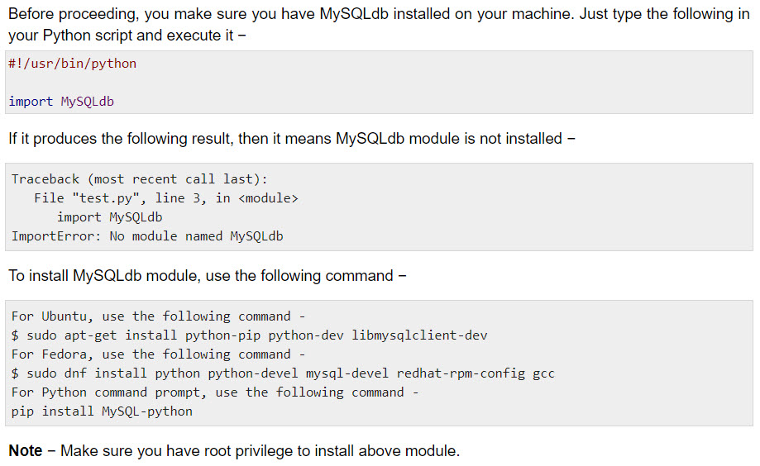
How do I Install MySQLdb ?

Slide 6
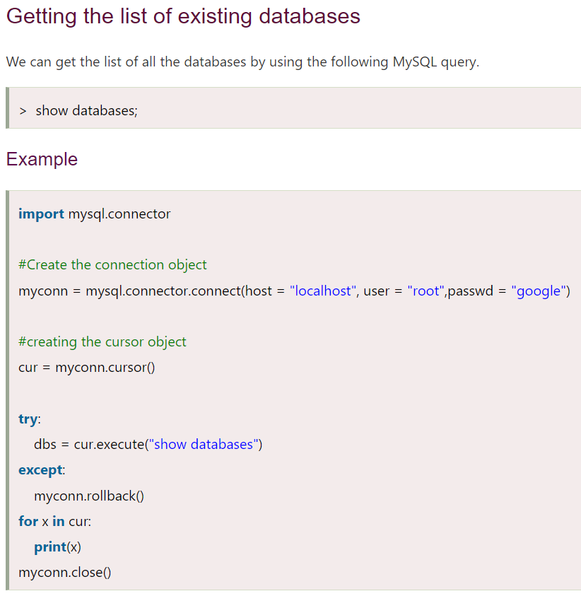
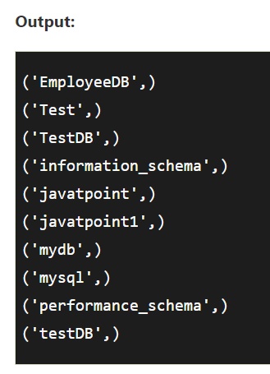
Creating new databases

Slide 7
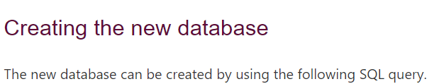

Creating new databases

Slide 8
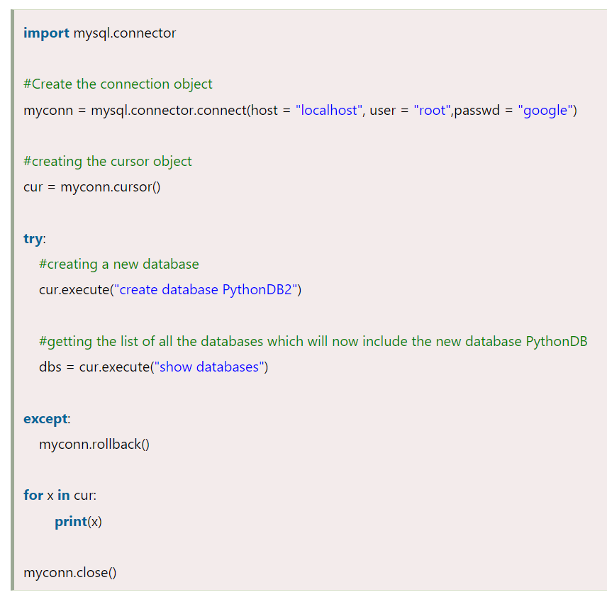
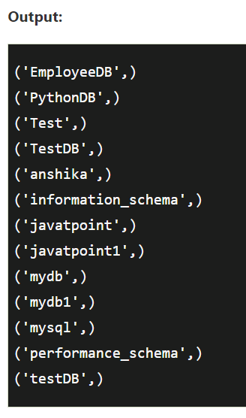
Creating new databases

Slide 9
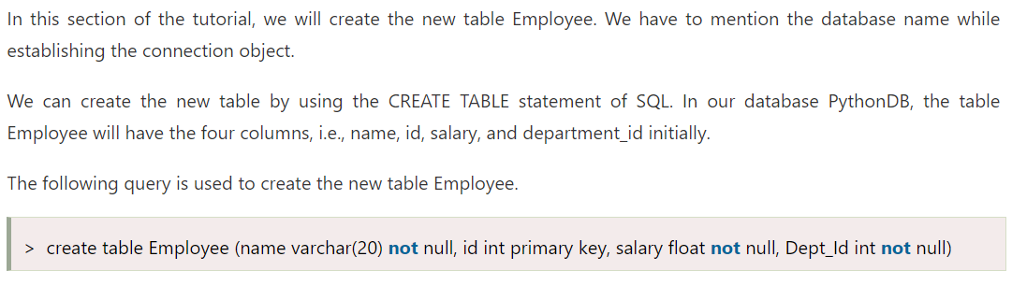
Creating the table

Slide 10
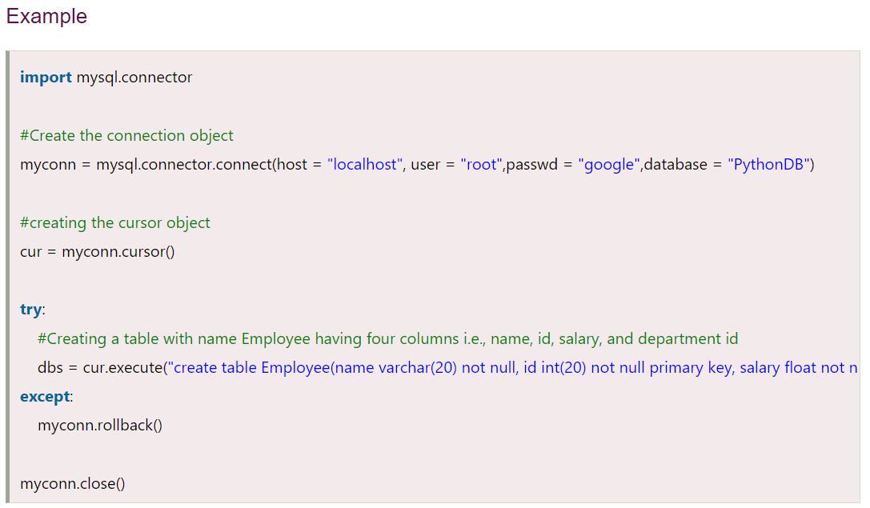
Creating the table

Slide 11
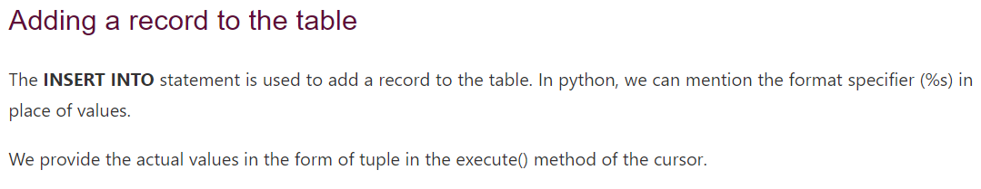
Insert Operation

Slide 12
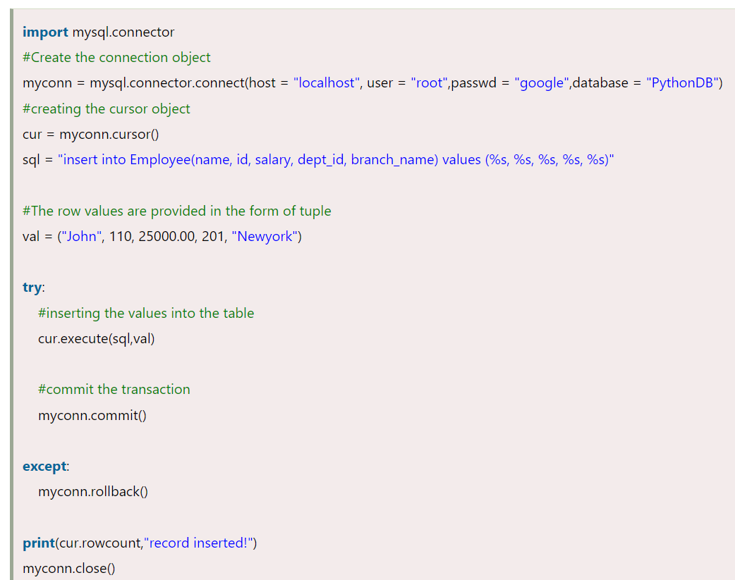
Insert Operation

Slide 13
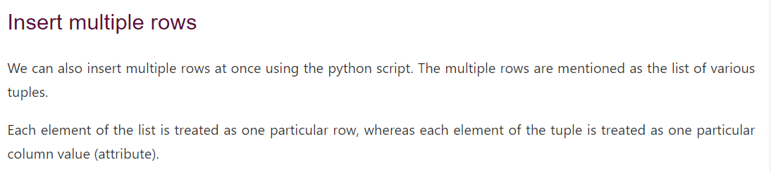
Insert Operation

Slide 14
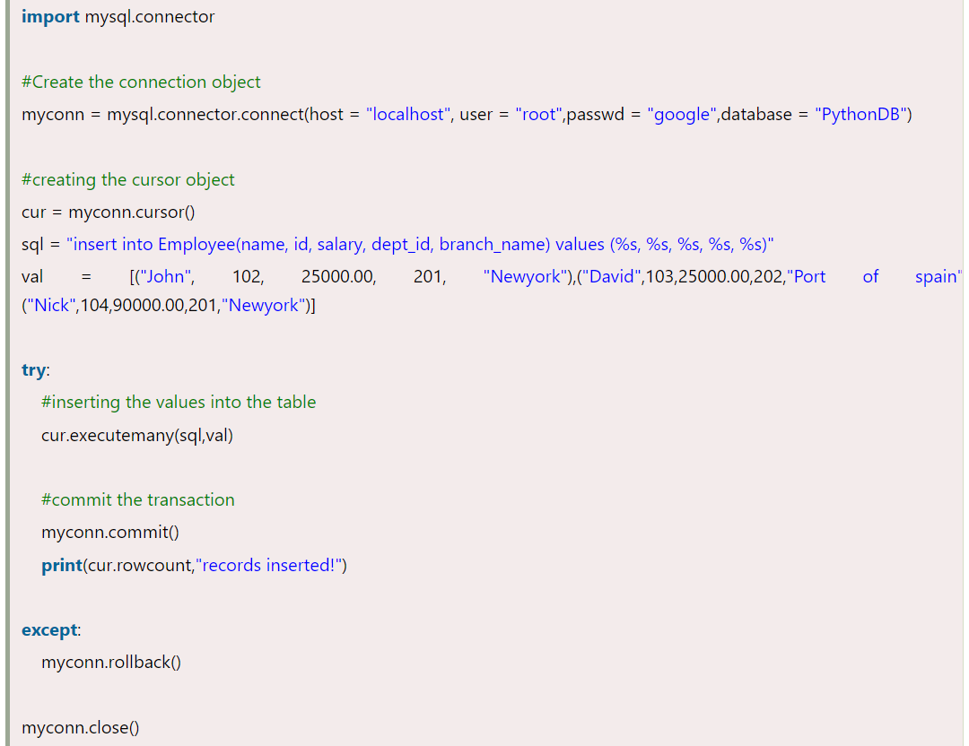
Insert Operation

Slide 15
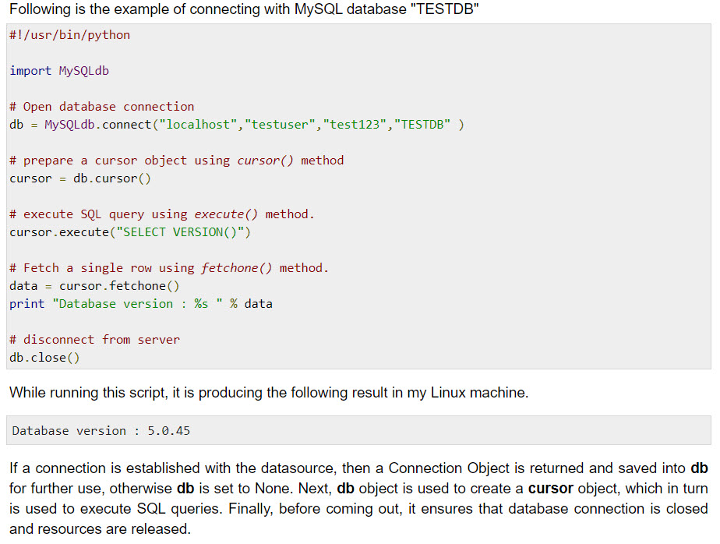
Database Connection

Slide 16
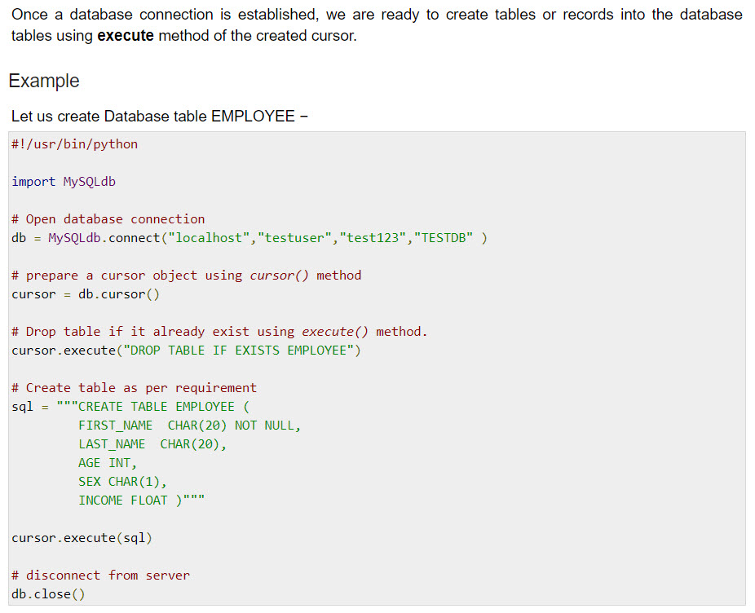
Creating Database Table

Slide 17
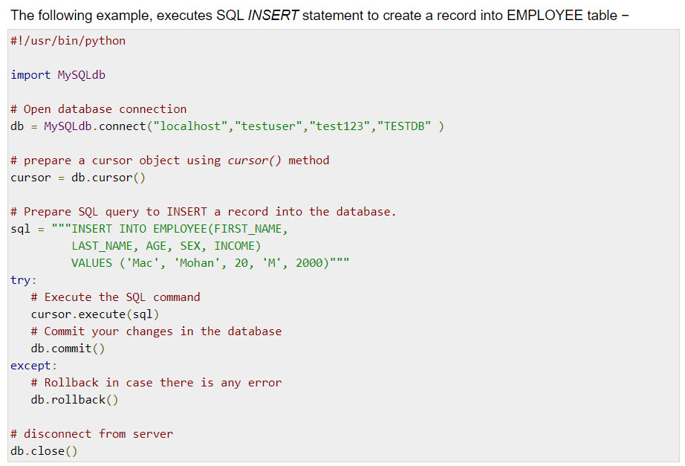
INSERT Operation

Slide 18
READ Operation
READ Operation on any database means to fetch some useful information from the database.
Once our database connection is established, you are ready to make a query into this database. You can use either fetchone() method to fetch single record or fetchall() method to fetech multiple values from a database table.
  fetchone() − It fetches the next row of a query result set. A result set is an object that is returned when a cursor object is used to query a table.
  fetchall() − It fetches all the rows in a result set. If some rows have already been extracted from the result set, then it retrieves the remaining rows from the result set.
  rowcount − This is a read-only attribute and returns the number of rows that were affected by an execute() method.

Slide 19
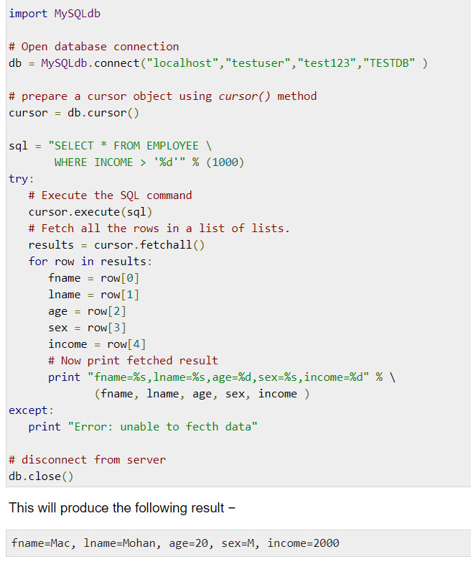
READ Operation

Slide 20
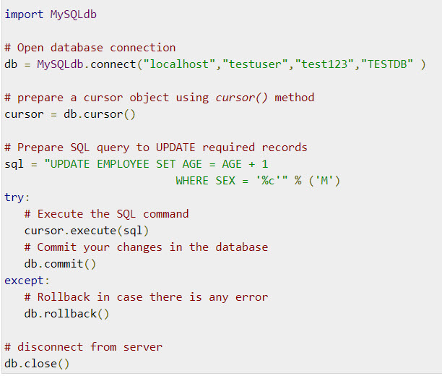
Update Operation
UPDATE Operation on any database means to update one or more records, which are already available in the database.
The following procedure updates all the records having SEX as 'M'. Here, we increase AGE of all the males by one year.
Example

Slide 21
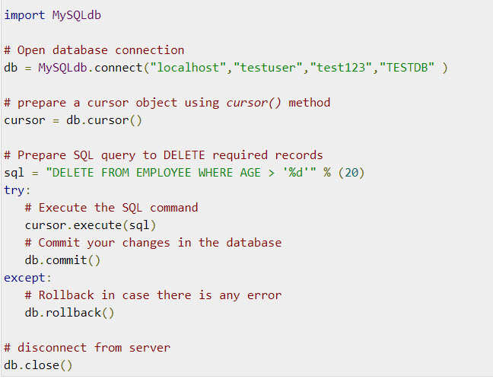
DELETE Operation
DELETE operation is required when you want to delete some records from your database. Following is the procedure to delete all the records from EMPLOYEE where AGE is more than 20 −
Example

Slide 22
Summary
Database manipulating with Python
CRUD Operations with Python

